Slide 1
Virtual room 57
Order book system

Slide 2
Group members
Siddhartha Vaddempudi
Dharani Dhar
Asif Shaik
Neema Jaleel
Maneesha C
Pathan Subhan Ali Khan
Pramod
Sathwika Kodam
Pasari Srilaxmi

Slide 3
Technologies used
Django
HTML
CSS
JavaScript
Python

Slide 4
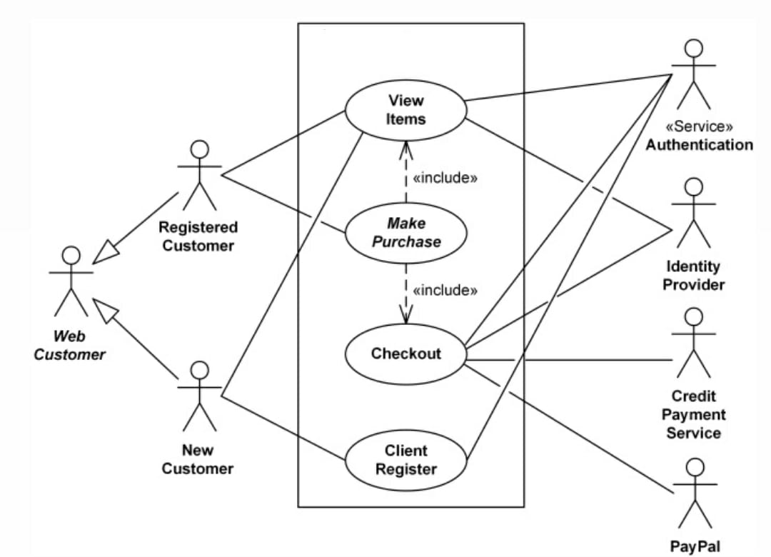
Architecture diagram

